Slide 1
Android Installation Guide (2)
Notes:
1

Slide 2
Outline
Install JDK
Install Android SDK
Install Eclipse
Install Eclipse Plug-ins for Android
Sample Project: Hello, Android
Notes:
2

Slide 3
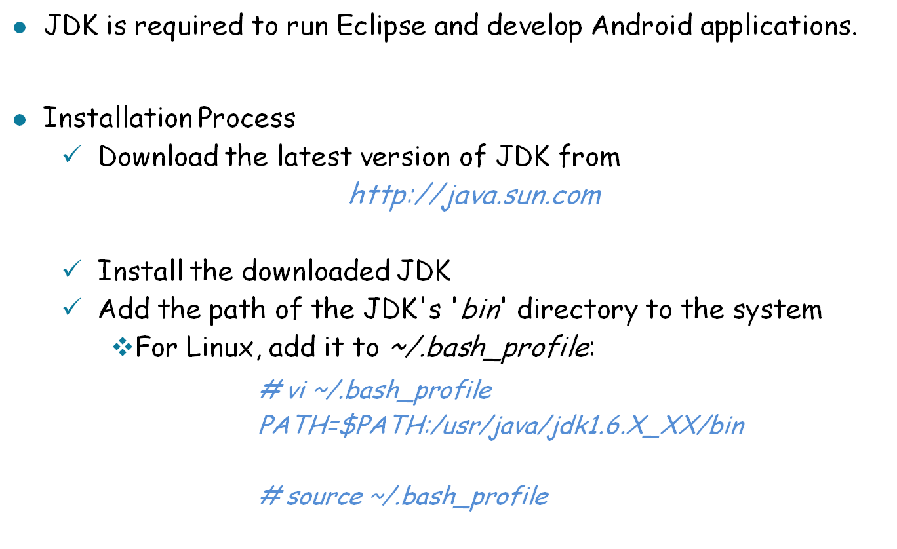
Installation - JDK

Slide 4
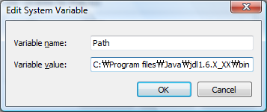
Installation - JDK (Cont.)
Installation Process (Cont.)
    For Windows, add it to Environment Varaibles:

Slide 5
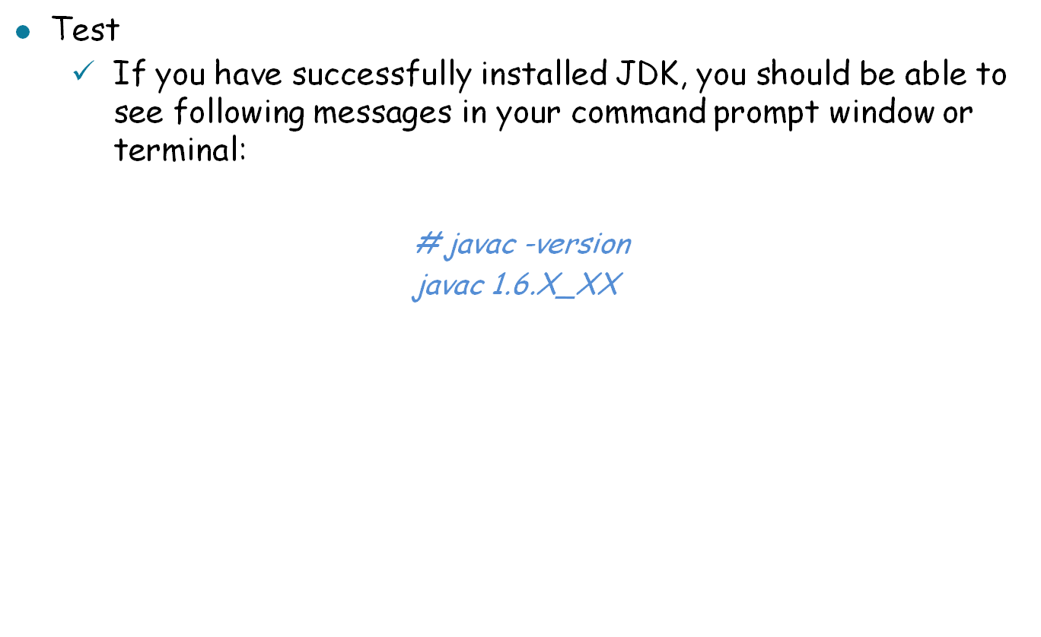
Installation - JDK (Cont.)

Slide 6
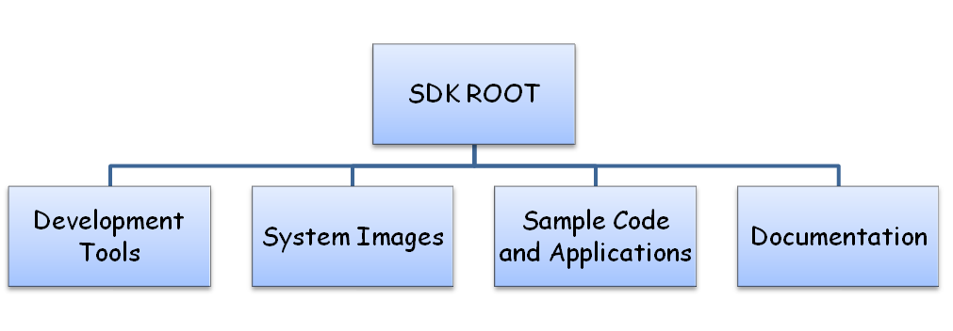
Installation - Android SDK
Android SDK Source Tree
Directory | Description
Development Tools | A variety of tools for developing and debugging application code and designing an application UI
System Images | Android 1.1 system images
Sample Code and Applications | A variety of tutorials and samples
Documentation | A full set of local documentation

Slide 7
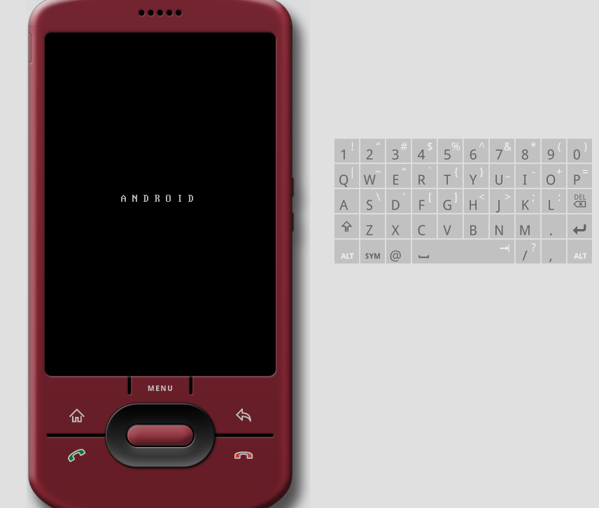
Installation - Android SDK (Cont)
Development Tools
  Two most important tools
    The Android emulator
    The Android development tools plug-in for Eclipse

Slide 8
Installation - Android SDK (Cont)
Development Tools (Cont)
  Hierarchy Viewer
    A tool that allows developers to debug and optimize user interface
    Providing a visual representation of layout's hierarchy of Views and a magnified inspector of the current display with a pixel grid
  Android Debug Bridge (adb)
    A tool that enables:
      installation of Android Package Files (.apk) on an emulator ot device from a command line
      linking a standard debugger to applications code running on an emulator or device

Slide 9
Installation - Android SDK (Cont)
Development Tools (Cont)
  Draw 9-patch
    A WYSIWYG graphic editor that offers a handy way to create NinePatch images
    NinePatch image
      A strechable bitmap image which Android will automatically resize to accomodate the contents of the View where it is placed as the background
      A standard PNG image that includes an extra 1-pixel-wide border
  Android Asset Packaging Tool (aapt)
    A tool that lets developers create Android Package Files (.apk) containing the binaries and resources

Slide 10
Installation - Android SDK (Cont)
Development Tools (Cont)
  Dalvik Debug Monitor Service (ddms)
    A tool that lets developers manage processes on an emulator or device and assists in debugging
    Functions
      Killing processes
      Selecting a specific process to debug
      Generating trace data
      Viewing heap and thread information
      Taking screenshots of the emulator or device

Slide 11
Installation - Android SDK (Cont)
Development Tools (Cont)
  Android Interface Description Language (aidl)
    A language that lets developers generate code for an inter-process interface, such as what a service might use
  sqlite3
    A tool that lets you access the SQLite data files created and used by Android applications
  Traceview
    A tool that produces graphical analysis views of trace log data that developers can generate from Android application

Slide 12
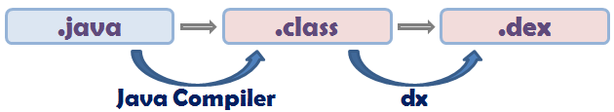
Installation - Android SDK (Cont)
Development Tools (Cont)
  mksdcard
    A tool that helps developers create a disk image that can be used with the emulator, to simulate the presence of an external storage card (such as an SD card)
  dx
    A tool that rewrites .class bytecode into Android bytecode (.dex)

Slide 13
Installation - Android SDK (Cont)
Development Tools (Cont)
  UI/Application Exerciser Monkey
    A program that runs on emulator or device with generating pseudo-random streams of user events (clicks, touches, or gestures), as well as a number of system-level events
    Can be used to stress-test applications being developed
  activitycreator
    A script that generates And build files to compile Android applications
  More detail information is available with the following link:
  http://developer.android.com/guide/developing/tools/index.html

Slide 14
Installation - Android SDK (Cont)
Installation Process
  Download the Android SDK from:
http://developer.android.com/sdk/
  Unpack the compressed file into a location you prefer.
  Add the path to the SDK tools directory "<SDK ROOT>/tools" to ~/.bash_profile (Linux) or Environment Variables (Windows)

Slide 15
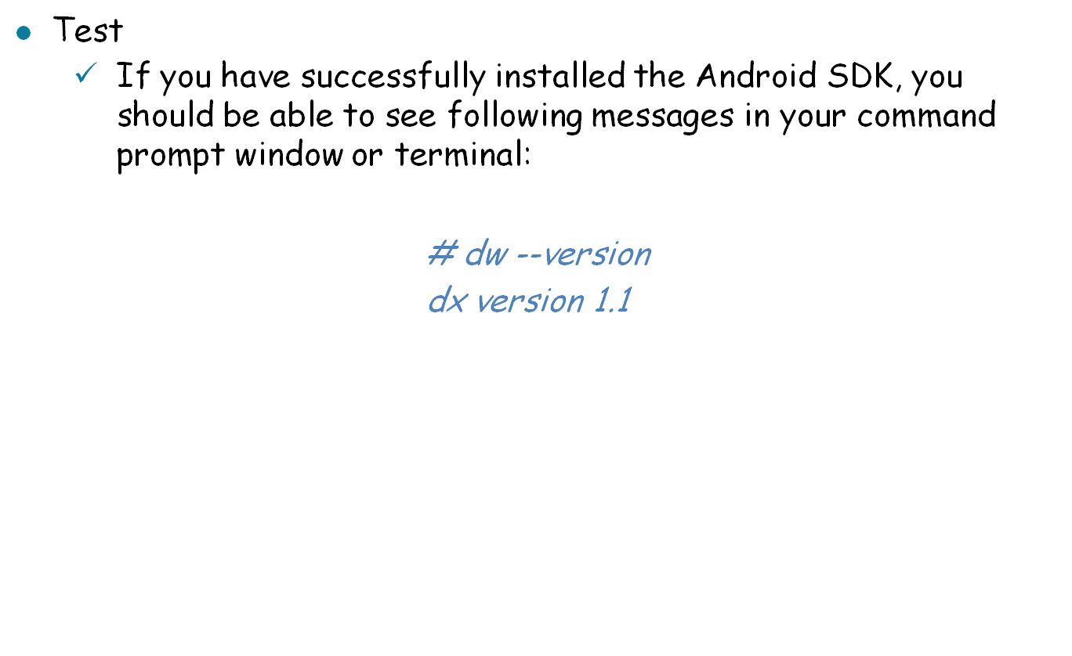
Installation - Android SDK (Cont)

Slide 16
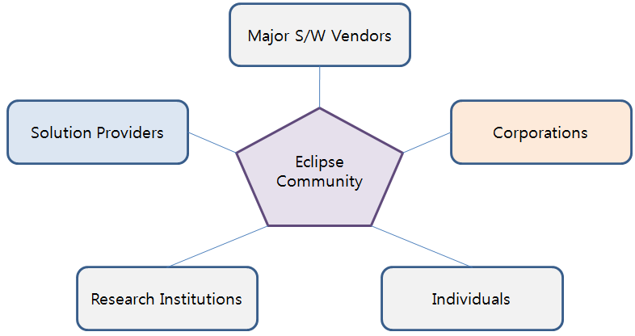
Installation - Eclipse
Eclipse
  An Integrated Development Toolkit licensed under Eclipse Public License
  An open source project developed by the Eclipse community:

Slide 17
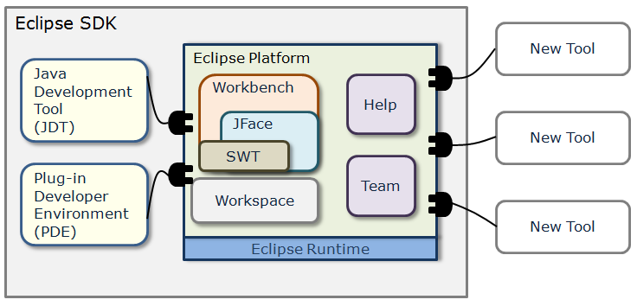
Installation - Eclipse (Cont)
Eclipse Platform
  The Eclipse platform defines an open architecture to allow plug-in developers to add a variety of function to the basic tooling platform.

Slide 18
Installation - Eclipse (Cont)
The Eclipse community provides various plug-ins:
Plug-in | Function
JDT | provides the capability to create, edit, navigate, build, and debug projects that use Java as a programming language
CDT | provides the capability to create, edit, navigate, build, and debug projects that use C and/or C++ as a programming language
UML2 | provides the capability to create UML models
... | ...

Slide 19
Installation - Eclipse (Cont)
Installation Process
  Download Eclipse from
  http://www.eclipse.org/downloads/
    Currently, a Java or RCP version of Eclipse 3.3 (Europa) or Eclipse 3.4 (Ganymede) are recommended.
  Unpack the downloaded file into a path you prefer. For example,
  /home/user1/eclipse (Linux)
  or
  C:\Program Files\eclipse (Windows)
  Add the path to .bash_profile (Linux) or Environment Variables (Windows)

Slide 20
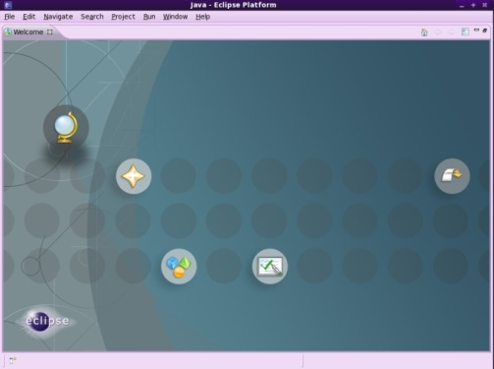
Installation - Eclipse (Cont)
Test
  If you have successfully installed the Android SDK, you should be able to see following application:
  # eclipse

Slide 21
Installation - Android Development Tools
ADT (Android Development Tools) provides a powerful, integrated enviornment to build Android applications.
Installation Process (based on Eclipse 3.4 Ganymede)
  Start Eclipse, then select Help > Software Updates....
  In the dialog that appears, click the Available Software tab.
  Click Add Site... and enter following location:
  http://dl-ssl.google.com/android/eclipse
  or
  https://dl-ssl.google.com/android/eclipse
  Back in the Available Software view, select the checkbox next to Developer Tools and click Install....

Slide 22
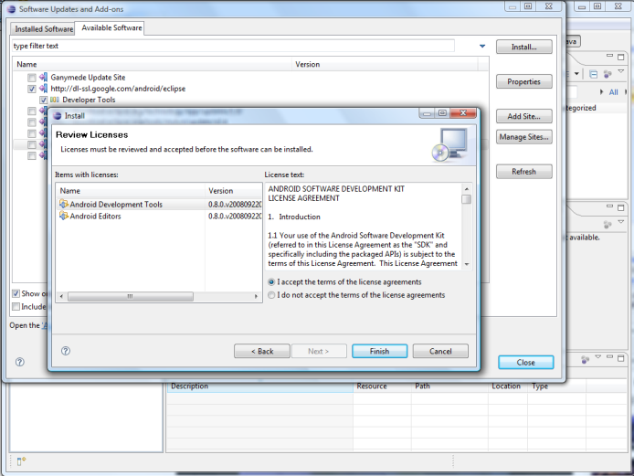
Installation - ADT (Cont)
Installation Process (Cont)
  On the subsequent install window, check both "Android Developer Tools" and "Android Editors".

Slide 23
Installation - ADT (Cont)
Installation Process (Cont)
  Accept the license agreement and click "Finish".
  Restart Eclipse.
  Modify Eclipse preferences to point to the Android SDK directory:
    Select Window > Preferences... to open the Preferences panel.
    Select Android from the left panel.
    For the SDK Location in the main panel, click Browse... and locate the SDK directory.
    Click Apply and then OK.

Slide 24
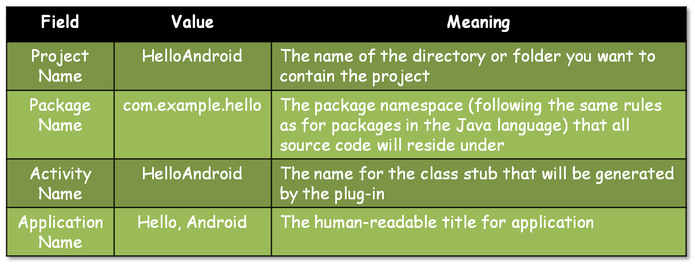
Sample Project - "Hello, Android"
Create "HelloAndroid" project.
  Select the File > New > Project menu item and select "Android Project" and click Next.
  Fill out the project details:

Slide 25
Sample Project - "Hello, Android" (Cont)
Take a look at HelloAndroid.java (HelloAndroid > src > com.android.hello) and modify the code like:
package com.android.hello;
import android.app.Activity;
import android.os.Bundle;
import android.widget.TextView;
public class HelloAndroid extends Activity {
/** Called when the activity is first created. */
@Override
public void onCreate(Bundle savedInstanceState) {
super.onCreate(savedInstanceState);
TextView tv = new TextView(this);
tv.setText("Hello, Android");
setContentView(tv);
}
}

Slide 26
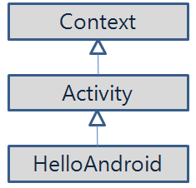
Sample Project - "Hello, Android" (Cont)
Source Description
  Creating a TextView object
  TextView tv = new TextView(this);
    A View (a drawable object) subclass that handles text
    The argument to TextView's constructor: an Android Context instance.

Slide 27
Sample Project - "Hello, Android" (Cont)
Source Description (Cont)
  Tell the TextView object to display a String:
  tv.setText("Hello, Android");
  Connect the TextView object with on-screen display:
  setContentView(tv);

Slide 28
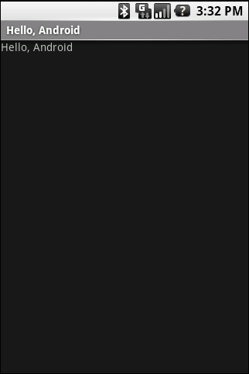
Sample Project - "Hello, Android" (Cont)
Test
  Select the Run > Run Configuration menu entry.
  Highlight the "Android Application" entry, and then click the icons in the top left corner (the one depicting a sheet of paper with a plus sign in the corner) or simply double-click the highlighted entry.
  Change the name "New_configuration" to something like "Hello Android".
  Pick the HelloAndroid project by clicking the "Browse" button.
  Click "Apply" and then "Run".

